Slide 1




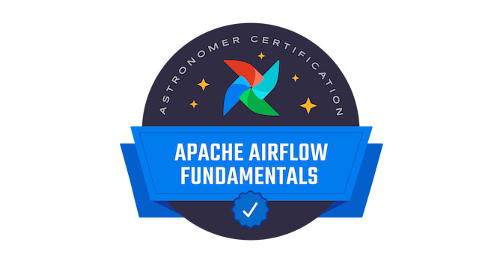
Gonzalo Lucena
SELECTED EXPERIENCE
Askaxiom AI agent (March 2025 – Present)
Developed text to sql Agentic Ai workflow nodes using python, langchain, neo4j and docker
Worked on Agents using the ReAct pattern, snowflake ai and Gemini Enterprise
Developed MCP tools for bigquery and neo4j connection.
Working on a Python ETL process integrated with Power BI dashboards.
Internal Audit Team (Sep 2021 – March 2025)
Using BigQuery to analyze data with SQL.
Working with Google Functions and Python scripts.
Using Composer to automate a workflow with Airflow as an orchestrator.
Running and monitoring pipelines.
Using Terraform and Azure DevOps Pipelines.
Using Scrum and Kanban methodologies.
TENARIS V MODEL (Mar 2021 - Aug 2021)
Working with Azure Cloud tools to migrate the client´s systems.
Using Azure Virtual Machines to deploy an Airflow demo.
Developing and testing Python scripts for ACL automatization..
DAS (Ene 2015 - Mar 2021)
Developed a mobile app in Java with Android Studio.
Developed a desktop app with C++ and SQL.
Developed, tested and deployed brand new ETL and automatization tools with C# and Python, and improved on existing processes.
Administered a RDBMS using SQL.
AI LLM Technology Arch Sr Analyst
Technology AI | LATAM HUB
gonzalo.lucena@accenture.com
Buenos Aires, Argentina
PROFESSIONAL BACKGROUND
AREA OF EXPERTISE
I´m quick to adapt to new technologies and situations, with a strong sense of responsibility and a constant predisposition to face obstacles and solve problems using teamwork and communication.
HARD/SOFT SKILLS & TOOLS
Software Engineering: Python, SQL, C/C++/C#, Java, Javascript,
Cloud: GCP and Azure Certified.
Management: Azure DevOps
Big Data: Databricks, Bigquery
DB: SQL, NoSQL, HeidiSQL
Methodologies: Scrum, Kanban
Versioning: GitHub
AI: Agents, langchain, langfuse, neo4j, Machine Learning, text to sql llm, Model training, feature engineering
EDUCATION
Bachelor's Degree in Information Technology (UP)
Systems Analyst (IIDE)
SPECIALIZATIONS
Certifiación Azure Fundamentals
Certifiación GCP Professional Data Engineer
Certifiación Airflow Fundamentals
Certifiación GCP Professional ML Engineer
LANGUAGES
INDUSTRY
Spanish (Native)
English (Proficient-C2)
Japanese (Beginner)
LSA (Advanced)
Data Platform
Data & AI
AI Solutions
Accenture Applied Intelligence

Slide 2

Gonzalo Lucena
EXPERIENCIA
Askaxiom AI agent (March 2025 – Present)
Desarrollado nodos de un Agentic Ai workflow de text to sql usando python, langchain, neo4j y docker
Trabajado con Agentes usando el patrón ReAct, snowflake ai y Gemini Enterprise
Desarrollado herramientas MCP para conectar el agente a bigquery y neo4j.
Trabajado en un proceso ETL con Python integrado a dashboards de Power BI.
Accenture CIO (Sep 2021 – Present)
Usando BigQuery para analizar data con SQL.
Trabajando con Google Functions y scripts de Python.
Usando Composer para automatizar workflows con Airflow como orquestador.
Ejecutando y monitoreando pipelines.
Usando Terraform y Azure DevOps Pipelines.
Usando metodologías Scrum y Kanban.
TENARIS V MODEL (Mar 2021 - Aug 2021)
Trabajando con herramientas Azure Cloud para migrar los sistemas del cliente.
Usando Azure Virtual Machines para generar una demo de Airflow.
Desarrollando y probando scripts de Python para procesos de ACL.
DAS (Ene 2015 - Mar 2021)
Desarrollando una app mobile en Java con Android Studio.
Desarrollando una app de escritorio con C++ y SQL.
Desarrollando, probando e implementando herramientas de ETL y automatización con C# y Python, y mejorando procesos ya existentes.
Administrando una RDBMS usando SQL.
AI LLM Technology Arch Sr Analyst
Technology AI | LATAM HUB
gonzalo.lucena@accenture.com
Buenos Aires, Argentina
PERFIL PROFESIONAL
AREAS DE EXPERIENCIA
Soy rápido para adaptarme a las nuevas tecnologías , con un fuerte sentido de la responsabilidad y una predisposición constante para enfrentar obstáculos y resolver problemas utilizando el trabajo en equipo y la comunicación.
HABILIDADES Y HERRAMIENTAS
Software Engineering: Python, SQL, C/C++/C#, Java, Javascript,
Cloud: GCP and Azure Certified.
Management: Azure DevOps
Big Data: Databricks, Bigquery
DB: SQL, NoSQL, HeidiSQL
Methodologies: Scrum, Kanban
Versioning: GitHub
AI: Agents, langchain, langfuse, neo4j, Machine Learning, text to sql llm, Model training, feature engineering
EDUCACION
Licenciatura en Tecnologías de la Información (UP)
Analista de Sistemas (IIDE)
ESPECIALIZACIONES
Certifiación Azure Fundamentals
Certifiación GCP Professional Data Engineer
Certifiación Airflow Fundamentals
Certifiación GCP Professional ML Engineer
IDIOMAS
INDUSTRIA
Inglés (Avanzado-C2)
Japonés (Básico)
Español (Nativo)
LSA (Avanzado)
Data Platform
Data & AI
AI Solutions
Accenture Applied Intelligence

